Slide 1
Week 06 Solution
Stacey Wang

Slide 2
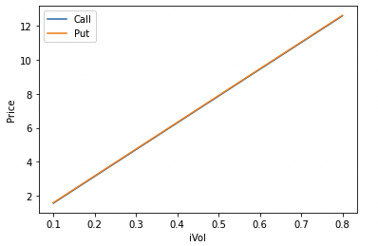
Problem 1
When strike price = current price, the shape of implied volatilities for both call and put are linear and appear to be overlapping completely

Slide 3
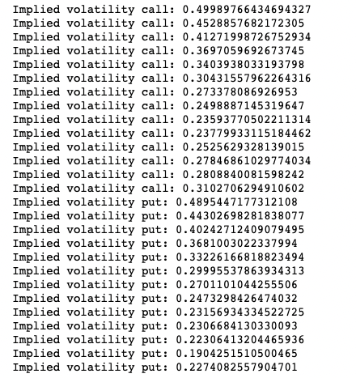
Problem 2

Slide 4
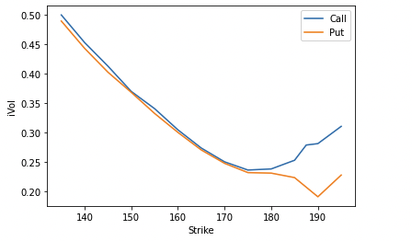
Problem 2
The graph shows that when the options are in the money, it is more expensive than when the options are out of money

Slide 5
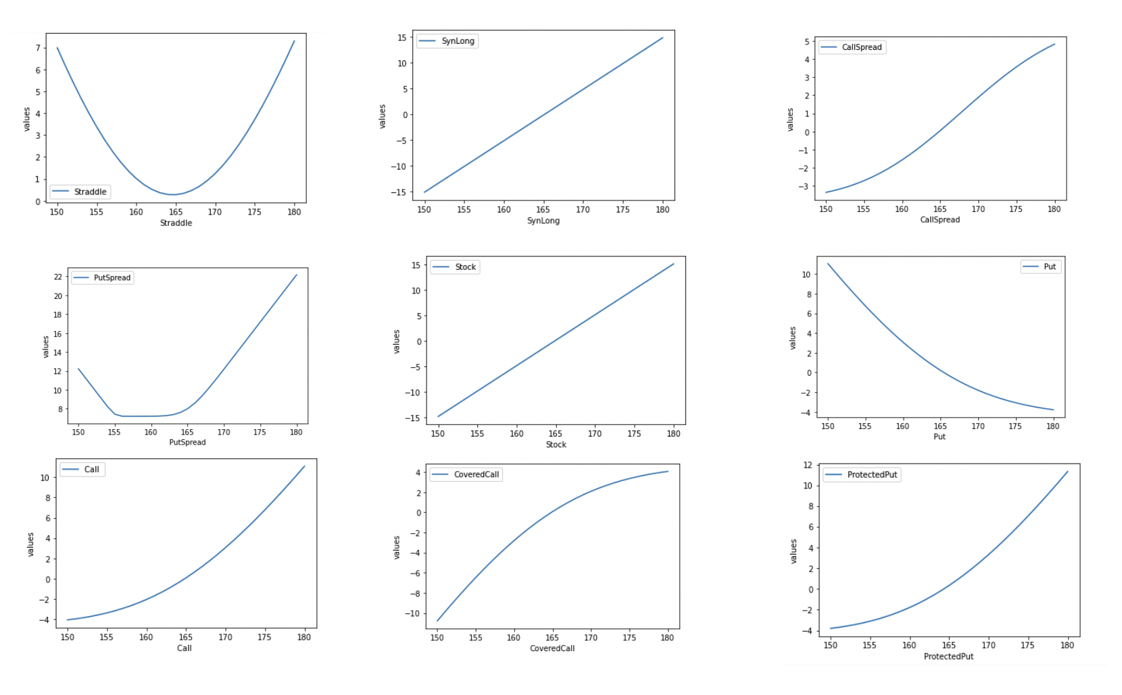
Problem 3

Slide 6
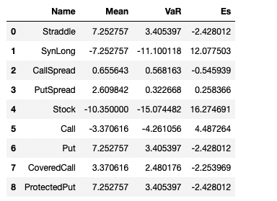
Problem 3 - Conclusion
Straddle has the least ES because it lower the risk by hedging a call and a put
SynLong and Stock has significantly small VaAr because SynLong simulates stock prices

